Slide 1
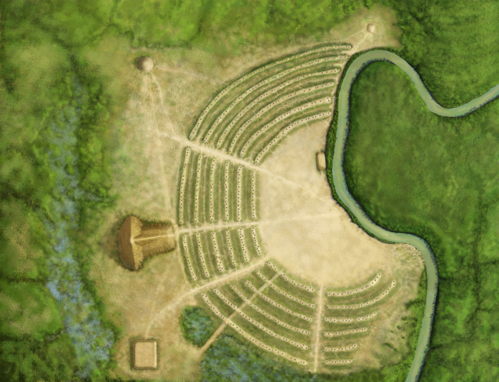
Poverty Point
Picture by Herb Roe
Picture by Herb Roe
Notes:
Poverty Point – 1700 B.C. to 1100 B.C.
Located in West Carroll Parish near the town of Epps
Occupation 1700 BC – 1100 BC
Largest Earthworks in North America at the time
Image credit: Herb Roe

Slide 2
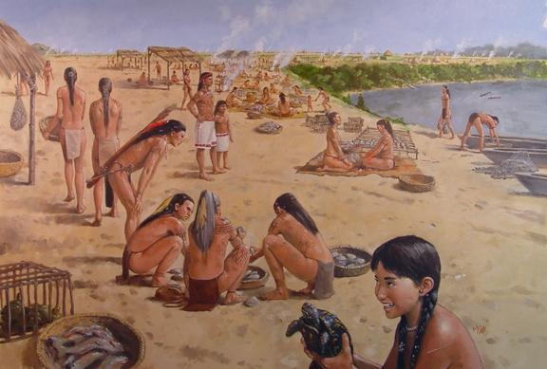
Painting by Martin Pate
Notes:
In this module, we’ll take a look at the people, landscape features, and artifacts from Poverty Point. You will learn what archaeologists have discovered, and what these discoveries tell us about this unique site.
This is a painting of what everyday life might have been like for the people of Poverty Point. Thanks to animal and plant remains, we know their diet consisted largely of fish, turtles, deer, opossum, gray squirrel, hickory nuts, aquatic tubers, and persimmon, along with other wild foods. Most of the animal bones found on-site were from locally caught fish.
Image credit: Martin Pate

Slide 3
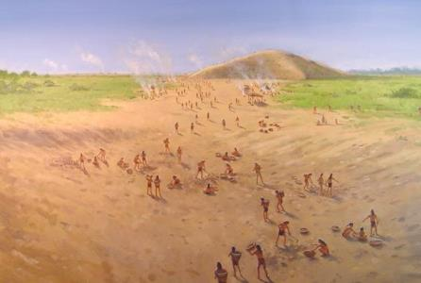
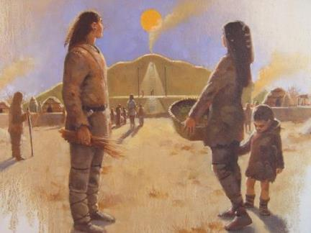
Poverty Point earthen mounds and ceremonies
Paintings by Martin Pate
People and ceremonies
Building earth mounds
Paintings by Martin Pate
Notes:
Poverty Point – 1700 B.C. to 1100 B.C.
Archaeologists learned how the people built the site and some of what they did there. For example, the people who built the earth mounds used many basket loads of soil. Artifacts left behind showed that many people lived at the site. Some artifacts may have been for special purposes, like ceremonies.
Here are two paintings illustrating life at Poverty Point. In the top picture we see people using basket loads of soil to build the earth mounds. The soil came from the ground surface near the mound that was being built. In the other picture we see how the people might have looked, and get an idea of the activities that took place at Poverty Point.
Image credit: Martin Pate

Slide 4
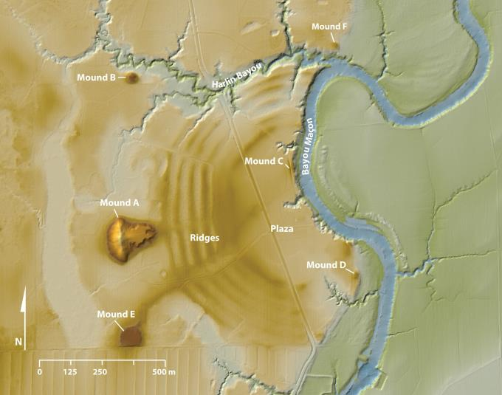
LiDAR map of Poverty Point
Modern Road
Courtesy of FEMA and the State of Louisiana
Notes:
Poverty Point – 1700 B.C. to 1100 B.C.
Landscape
Large earth mounds are an important feature of Poverty Point. This is a LiDAR map of Poverty Point where you can easily see the mounds. Light detection and ranging, or LiDAR, can record features on the surface of the earth. LiDAR uses light in the form of laser pulses to make a three-dimensional image of the earth’s surface. Experts can take these images from an aircraft or from a satellite.
Poverty Point people built five mounds at the site. They are labeled A, B, C, E, and F. Mound D was built nearly 2000 years later. The earthworks cover an area of about 350 acres. We’ll take a closer look at these earth mounds in the next few slides.
Image credit: LiDAR data courtesy of FEMA and the state of Louisiana, distributed by “Atlas: The Louisiana Statewide GIS,” LSU CADGIS Research Laboratory, Baton Rouge, Louisiana

Slide 5
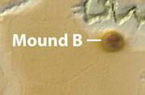
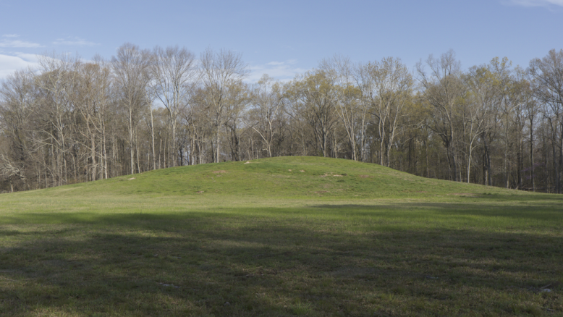
Mound B
Photograph © Jenny Ellerbe
Notes:
Poverty Point – 1700 B.C. to 1100 B.C.
Mound B is the oldest mound at the site. Mound B is 180 feet in diameter at the base, and 20 feet tall. Radiocarbon dated samples indicated the mound was built around 1650 B.C. The Poverty Point people built the mound in seven construction phases.
The floors of some of these construction phases had firepits, charcoal and postholes. This evidence indicates that activities did take place there. In at least three construction phases the top of the mound was flat. In the final construction phase, the mound top was made round, in the shape of a cone. Archaeologists once assumed that Mound B was a burial mound because of its round, conical shape, but no evidence has been found in the mound to support this idea.
Image credits:
Photograph – © Jenny Ellerbe
LiDAR – LiDAR data courtesy of FEMA and the state of Louisiana, distributed by “Atlas: The Louisiana Statewide GIS,” LSU CADGIS Research Laboratory, Baton Rouge, Louisiana

Slide 6
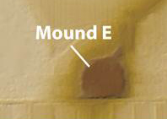
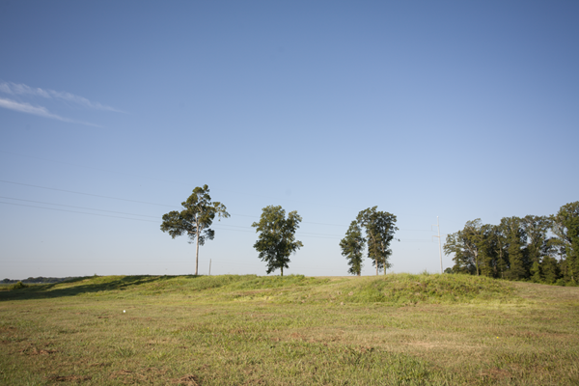
Mound E
Photograph © Jenny Ellerbe
Notes:
Poverty Point – 1700 B.C. to 1100 B.C.
Mound E is about 13 feet tall and 300 feet by 260 feet at its base. It was once larger, but historical farmers, who may not have realized that it was a mound, removed some of the dirt. The ramp on the corner of the mound was constructed during prehistoric times and Mound E was built in five stages, all with a flat-top. Archeologists think it was one of the earliest mounds built at the site, around the time of Mound B or just after.
Image credits:
Photograph – © Jenny Ellerbe
LiDAR – LiDAR data courtesy of FEMA and the state of Louisiana, distributed by “Atlas: The Louisiana Statewide GIS,” LSU CADGIS Research Laboratory, Baton Rouge, Louisiana

Slide 7
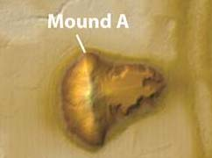
Mound A
Photograph © Jenny Ellerbe
Notes:
Poverty Point – 1700 B.C. to 1100 B.C.
Mound A is the largest mound at the site. It was built about 1300 B.C., which makes it one of the last mounds built at the site. Mound A measures 72 feet tall at the highest point with a platform of about 30 feet. It’s 710 feet long (east to west) by 660 feet wide (north to south) at the base. This is as big as a six to seven story building. It took over 8.4 million cubic feet (312,000 cubic yards) of soil to build Mound A. By comparison, a football field is 57,600 cubic feet. That’s 146 football fields! The people of Poverty Point would have used about 15.5 million basket loads of dirt that weighed 50 pounds each to build this mound. That’s 390,000 tons of dirt, or 15,000 dump truck loads.
People have different ideas about the shape of Mound A. What does it look like to you?
This photograph is taken halfway up the mound. Notice the people in this picture. They are very small compared to the upper part of mound. That gives you an idea of the size of Mound A. Archaeologists sometimes use people as scales when photographing large objects.
Image credits:
Photograph – © Jenny Ellerbe
LiDAR – LiDAR data courtesy of FEMA and the state of Louisiana, distributed by “Atlas: The Louisiana Statewide GIS,” LSU CADGIS Research Laboratory, Baton Rouge, Louisiana

Slide 8

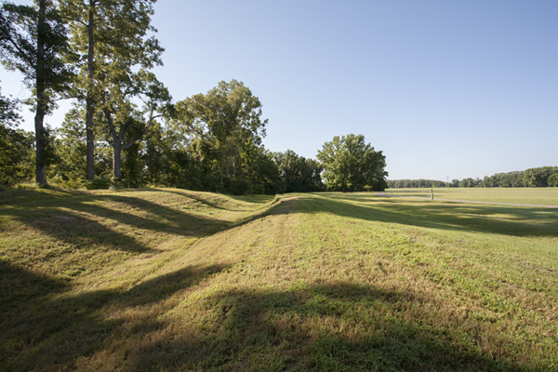
Mound C
Photograph © Jenny Ellerbe
Notes:
Poverty Point – 1700 B.C. to 1100 B.C.
Mound C is located in the plaza at Poverty Point. It is 260 feet long by 80 feet wide and about six feet tall. Mound C has 16 surfaces or “floors” of different color and texture soil. Some of the floors have evidence that people lived on them, such as artifacts, pits and postholes. A thick cap of soil was put over the mound during the last construction phase. Archaeologists know this is a Poverty Point mound, but are not sure where it fits in the sequence of mound building at the site.
Image credits:
Photograph – © Jenny Ellerbe
LiDAR – LiDAR data courtesy of FEMA and the state of Louisiana, distributed by “Atlas: The Louisiana Statewide GIS,” LSU CADGIS Research Laboratory, Baton Rouge, Louisiana

Slide 9
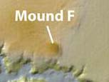
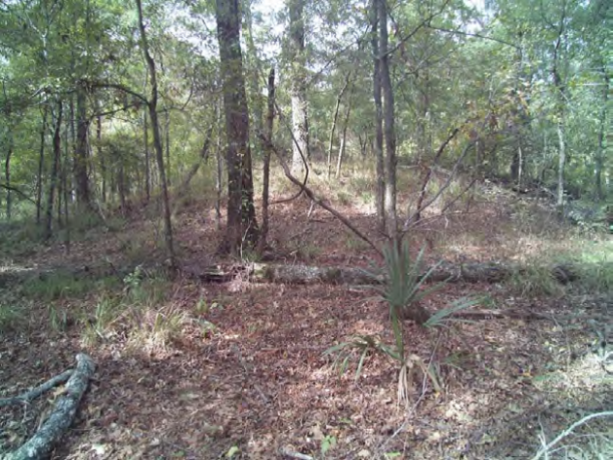
Mound F
Photograph by Diana Greenlee
Notes:
Poverty Point – 1700 B.C. to 1100 B.C.
Mound F is the smallest mound at Poverty Point. It measures 5 feet tall, and 80 feet by 100 feet at the base. Radiocarbon dated samples indicated the mound was built sometime after 1280 B.C. It was the last Poverty Point mound built at the site.
Image credits:
Photograph – Diana Greenlee
LiDAR – LiDAR data courtesy of FEMA and the state of Louisiana, distributed by “Atlas: The Louisiana Statewide GIS,” LSU CADGIS Research Laboratory, Baton Rouge, Louisiana

Slide 10
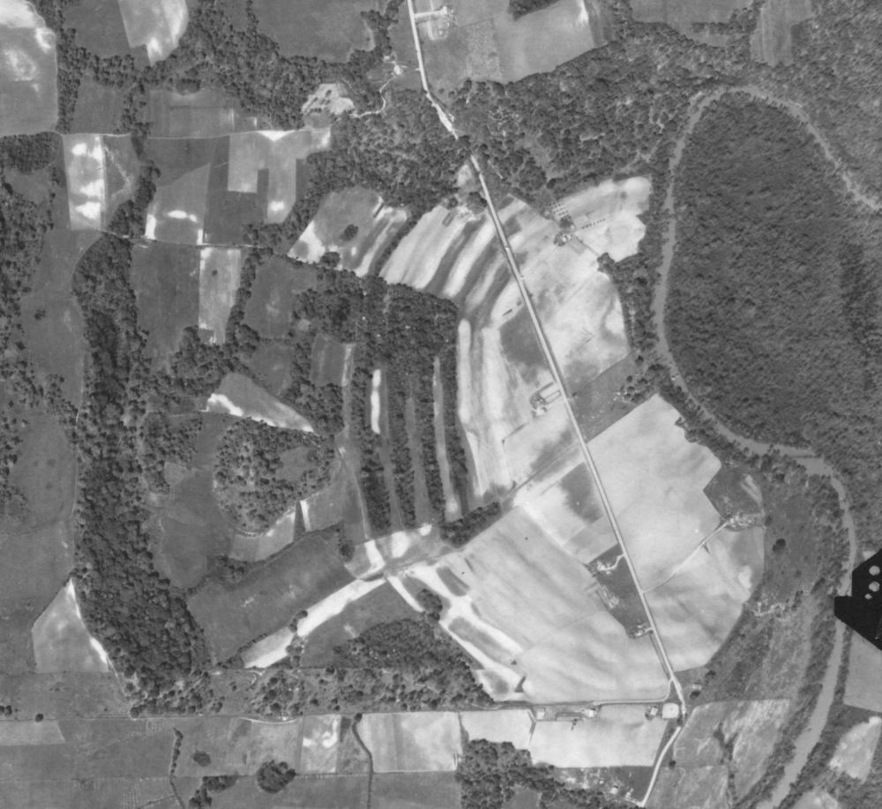
C-shaped earth ridges, Poverty Point
Courtesy of U.S. Army Corps of Engineers
Courtesy of FEMA and the State of Louisiana
Notes:
Poverty Point – 1700 B.C. to 1100 B.C.
Archaeologists have been working at Poverty Point since 1913. That’s when the first excavations took place at the site. However, it wasn’t until 1953 that they knew about the C-shaped earth ridges. (Read excerpt from Haag in Diana’s book). The ridges are so large that they are not easy to see from the ground.
Image credits:
Aerial photograph – United States Army Corps of Engineers
LiDAR – LiDAR data courtesy of FEMA and the state of Louisiana, distributed by “Atlas: The Louisiana Statewide GIS,” LSU CADGIS Research Laboratory, Baton Rouge, Louisiana

Slide 11
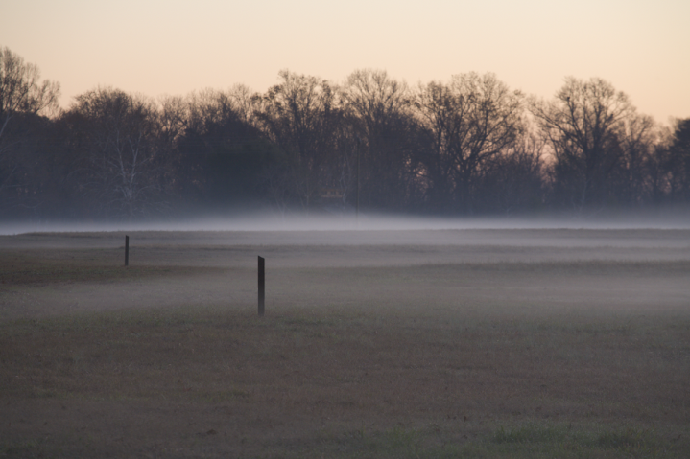
C-shaped earth ridges, Poverty Point
Photograph © Jenny Ellerbe
Notes:
Poverty Point – 1700 B.C. to 1100 B.C.
No other site in the world has a ridge system quite like the one at Poverty Point. There are six ridges. You can just make them out in the mist. The ridges range in height from a few inches to six feet. We think they would have been 6-9 feet tall in places. Time has a way of wearing down the landscape. However, the north part of the site is lower than the southern part of the site and the ridges in that area are more pronounced.
Habitation debris found during excavations tell us that people lived on the ridges. The outer ridge is over 6,500 feet long, and the inner ridge is about 4,100 feet long.
Image credit: © Jenny Ellerbe

Slide 12
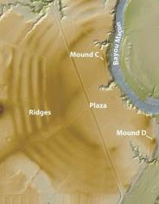
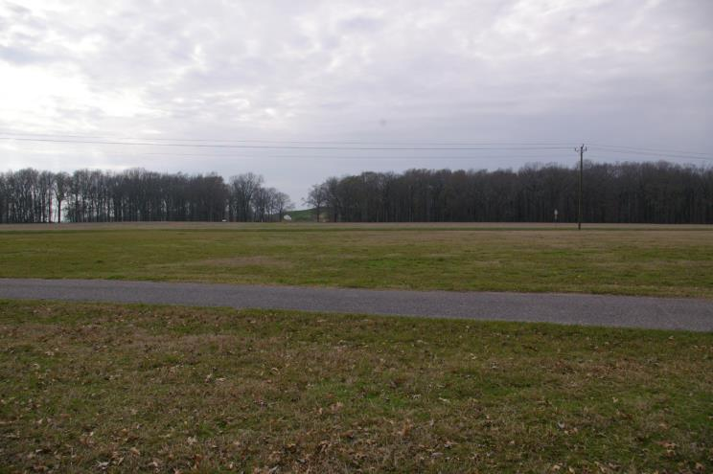
Plaza, Poverty Point
Area where postholes
were found
Photograph by Alisha Wright
Notes:
Poverty Point – 1700 B.C. to 1100 B.C.
The C-shaped ridges curve around a large flat plaza. Archaeologists found buried traces of large postholes that show where circles of posts once stood. Only a few artifacts have been recovered in this area of the site. But, they discovered that changes had taken place in the plaza through time. Poverty Point people sometimes added dirt to the area and leveled it out to make the area flat.
What archaeologists did find in the plaza were large postholes that show where circles of poles once stood. This is a photograph of part of the plaza area, and a LiDAR image of the area. Archaeologists discovered the postholes in the south end of the plaza, shown in the map by a circle.
Image credits:
Photograph – Alisha Wright
LiDAR – LiDAR data courtesy of FEMA and the state of Louisiana, distributed by “Atlas: The Louisiana Statewide GIS,” LSU CADGIS Research Laboratory, Baton Rouge, Louisiana

Slide 13
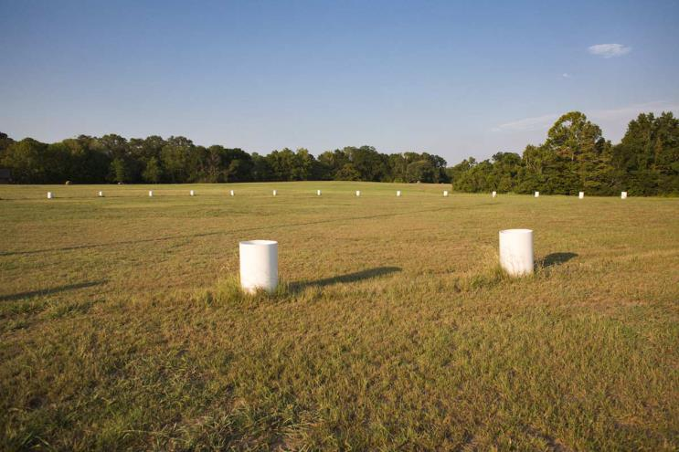
One of the circles in plaza at Poverty Point
Area where postholes
were found
Photograph © Jenny Ellerbe
Notes:
Poverty Point – 1700 B.C. to 1100 B.C.
Postholes were dug in the ground to support huge wooden posts. They were up to two feet in diameter. These wooden posts formed circles up to 213 feet across. At least 40 of these circles were in the plaza. In the picture, the ring of white cylinders shows the diameter of one circle. The original wooden posts were closer together than the white cylinders and presumably taller. Archaeologists have not yet discovered how these big circles of poles were used.
Image credit: © Jenny Ellerbe

Slide 14
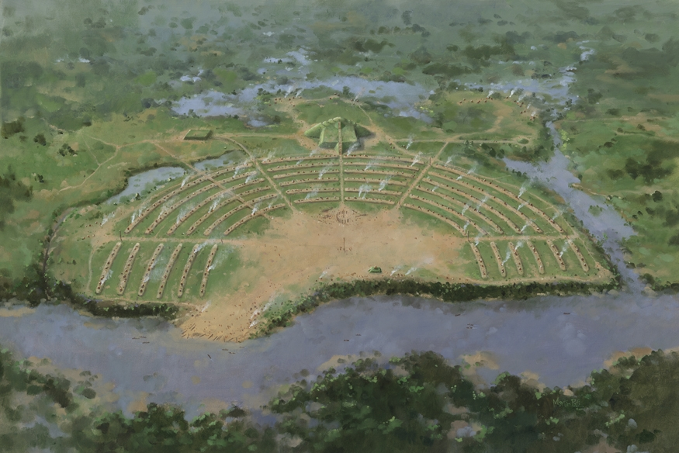
Trade and Travel
Painting by Martin Pate
Notes:
Poverty Point – 1700 B.C. to 1100 B.C.
Trade
Poverty Point was part of a large trade network. The location of the site was perfect for long distance trade. Poverty Point people built the site on Macon Ridge. This ridge is high, which protects it against flooding from nearby water sources. Several rivers are near Macon Ridge. One of the largest is the Mississippi River. Smaller waterways, such as Bayou Maçon, lie very close to the site. Indians used rivers and bayous to travel, much like we use roads today. These waterways were perfect for transporting goods and people.
Image credit: Martin Pate

Slide 15
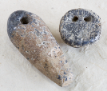
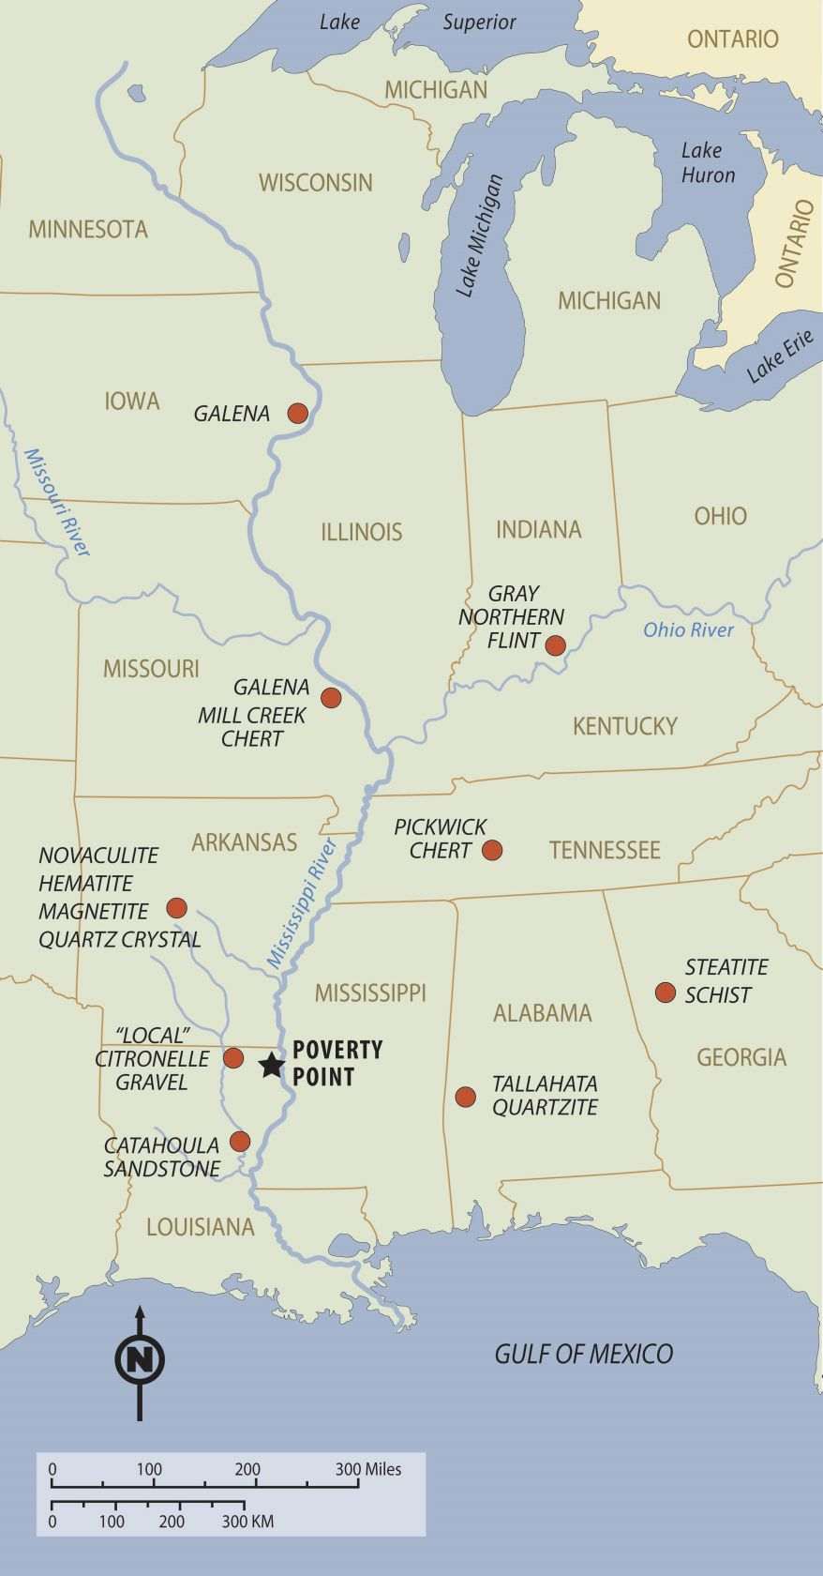



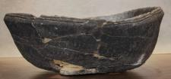
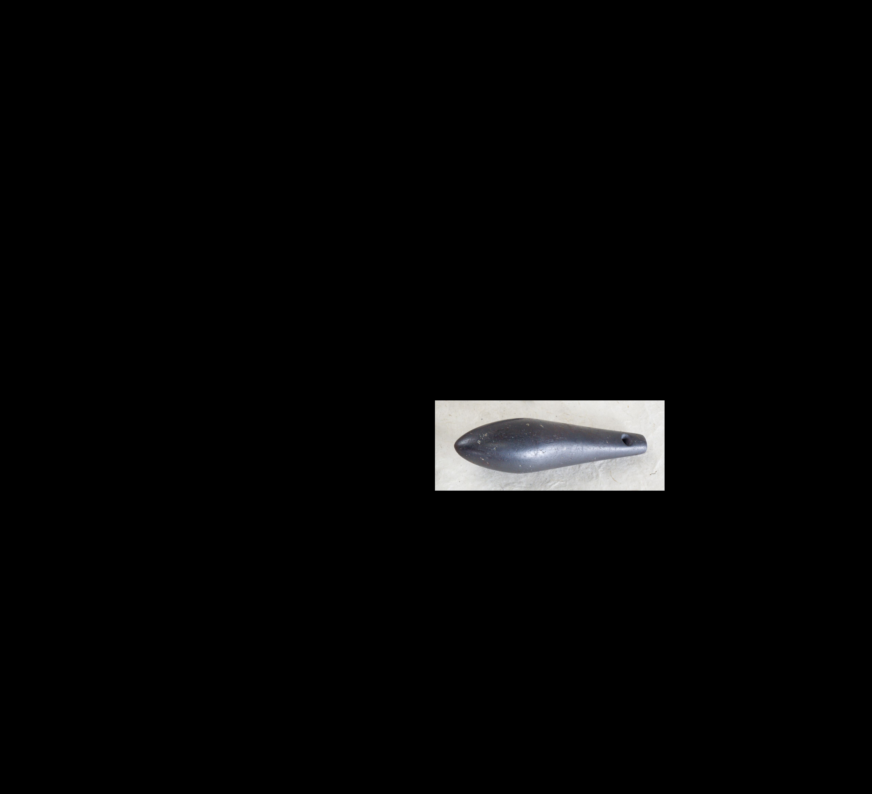
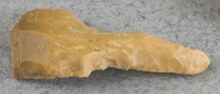
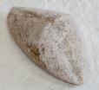

Stone and ore from Poverty Point
Gray Northern
Flint
Galena
Pickwick Chert
Mill Creek
Chert
Hematite
Steatite
“Local” Citronelle
Gravel
Catahoula Sandstone
Tallahata Quartizite
Artifact photographs © Jenny Ellerbe
Notes:
Poverty Point – 1700 B.C. to 1100 B.C.
Archaeologists know that Poverty Point was part of a long-distance trade network because of the objects discovered at the site. The area around Poverty Point does not have stone. However, there were many stone artifacts found at the site (over 78 tons). We were able to trace the stone to other areas of the United States, such as Iowa and the Appalachian Mountains. Archaeologists are not certain whether people brought stone to Poverty Point, or if people from the site traveled long distances to get the stone.
Here is a map of the different sources of stone and ore from Poverty Point, and a few examples from the site. The closest source was “local” Citronelle gravel about 25-30 miles northwest of the site. The most distant source was in Iowa, 650 miles away! Galena, a lead ore, was from that area. Notice that many of the source locations are along waterways.
Image credits:
Photographs – © Jenny Ellerbe

Slide 16
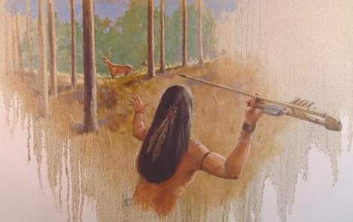
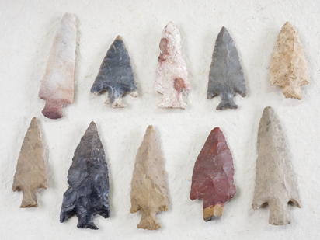
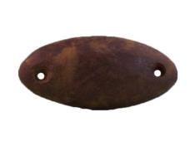
Hunting Technology
Stone Point
Weight
Artwork by Martin Pate
Atlatl Weight
Photograph by Diana Greenlee
Photograph © Jenny Ellerbe
Notes:
Poverty Point – 1700 B.C. to 1100 B.C.
Artifacts
Poverty Point people hunted with stone points and lightweight spears or darts. Archaeologists discovered many stone points at Poverty Point. On the left are a few examples from the site. Poverty Point people attached stone points to long, slender pieces of wood to make spears. Sometimes the spears were thrown with the atlatl. The spears were made of wood or cane while the atlatls were likely made of wood with antler or bone attachments. They increased the throwing power and distance of the spear. The people at Poverty Point used groundstone to make atlatl weights. The weights provided balance for the atlatl. On the right is a drawing of an atlatl, and an enlarged view of an atlatl weight.
Image credits:
Stone points – © Jenny Ellerbe
Atlatl weight – Diana Greenlee
Atlatl – Paula McIver

Slide 17
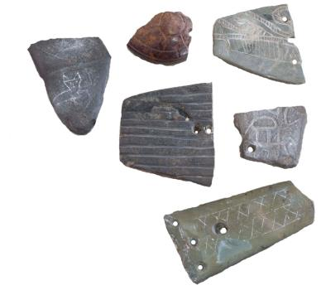
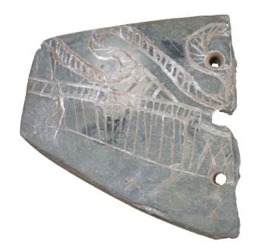
Groundstone gorgets
Photograph © Jenny Ellerbe
Notes:
Poverty Point – 1700 B.C. to 1100 B.C.
Archaeologists found many groundstone artifacts at Poverty Point. The people shaped and ground the stone using other stones and water or sand. There were decorations on some of the ground stone.
Archaeologists found flat, oblong stone artifacts called gorgets. Poverty Point people might have used them as personal art worn around the neck, like jewelry. Here are some examples of gorgets found at Poverty Point. The close up image shows designs found on one item.
Image credit: © Jenny Ellerbe

Slide 18
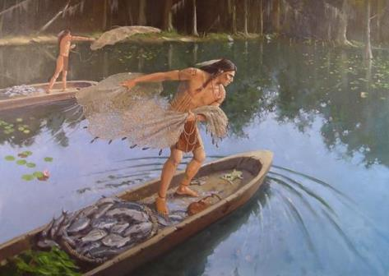
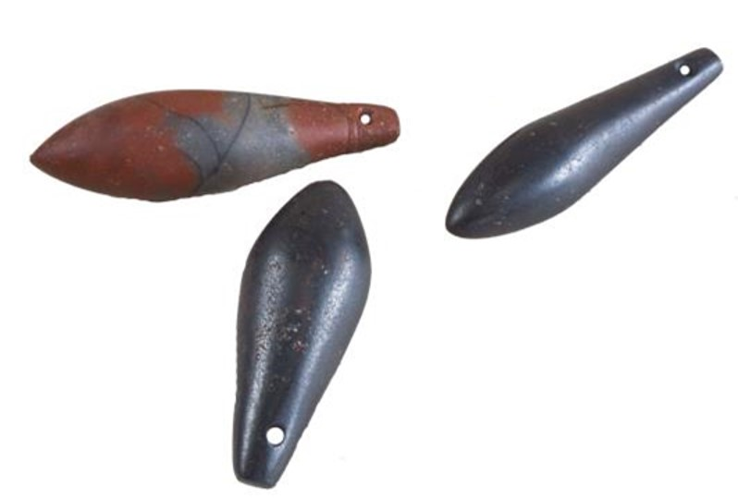
Groundstone plummets
Artwork by Martin Pate
Photograph © Jenny Ellerbe
Notes:
Poverty Point – 1700 B.C. to 1100 B.C.
Archaeologists found groundstone plummets at Poverty Point. Initially, plummets were thought to have served as bola or net weights, likely on fishing line or cast nets, or as charmstones for religious ceremonies. However, recent analyses suggest some may have been used as loom weights.
Image credit: © Jenny Ellerbe

Slide 19
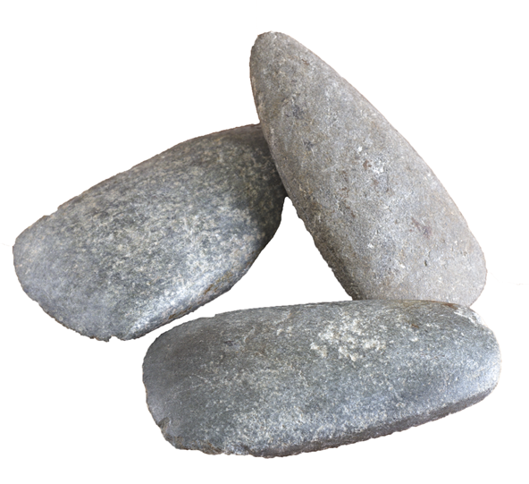
Groundstone celts
Photograph © Jenny Ellerbe
Notes:
Poverty Point – 1700 B.C. to 1100 B.C.
Archaeologists discovered groundstone celts at Poverty Point. A celt is a kind of tool, like an axe. They were used for chopping or shaping wood and might have been used as hoes for grubbing tubers or loosening soil for removing dirt.
Image credit: © Jenny Ellerbe

Slide 20
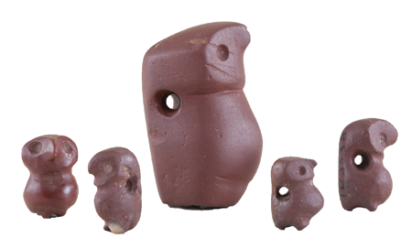

Red jasper owl pendants
Photograph © Jenny Ellerbe
Notes:
Poverty Point – 1700 B.C. to 1100 B.C.
The pot-bellied, owls, are considered a classic artifact of the Poverty Point culture. Nearly thirty owls have been recovered. However, most were found at sites spanning from eastern Florida to western Louisiana. All recovered pendants are surface finds. None of the pendants were found during an excavation. Each piece has a hole in the back. It could have been worn as a necklace or decoration. The largest owl is 1.1 inches tall.
Image credit: © Jenny Ellerbe

Slide 21
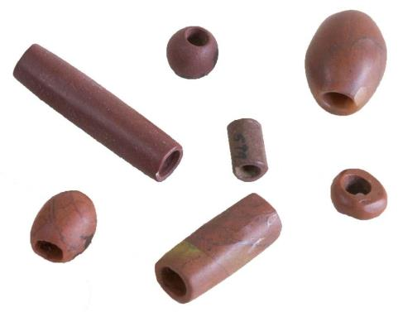
Beads
Photograph © Jenny Ellerbe
Notes:
Poverty Point – 1700 B.C. to 1100 B.C.
Poverty Point people made beads out of highly polished chert stone, fired earth, steatite, galena, quartz, copper, and greenstone. Native Americans used a variety of tools (such as stone drills) and techniques to make the holes. One technique involved the use of a hollow bit, likely cane and sand, to make the hole. They might have worn the beads around the neck, like jewelry, or attached to clothing.
Image credit: ©Jenny Ellerbe

Slide 22
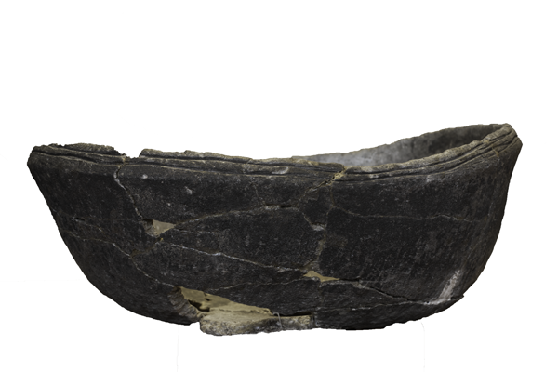
Steatite bowl
Photograph © Jenny Ellerbe
Notes:
Poverty Point – 1700 B.C. to 1100 B.C.
In Louisiana, ceramic pottery was just beginning to be made at the time of Poverty Point. Archaeologists did not find much of it at the site. Poverty Point people used more stone bowls to cook and store food than pottery containers. The stone bowls were brought from northern Georgia or Alabama. They are made of steatite, or soapstone, a stone that is very soft and easy to carve. Here is an example of a steatite stone bowl.
Image credit: © Jenny Ellerbe

Slide 23
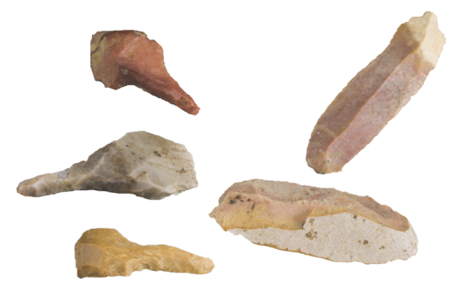
Stone microliths
Perforators
microblades
Photograph © Jenny Ellerbe
Notes:
Poverty Point – 1700 B.C. to 1100 B.C.
Archaeologists discovered small stone tools called microliths. “Micro” means small and “lith” means stone. In this photograph we see microliths for cutting or scraping. Microblades have sharp edges and were multipurpose tools.
Image credit: © Jenny Ellerbe

Slide 24
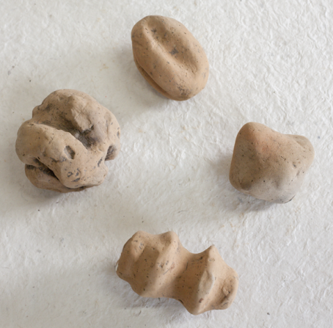
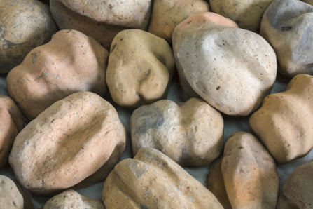
Poverty Point Objects (PPOs)
Photographs © Jenny Ellerbe
Notes:
Poverty Point – 1700 B.C. to 1100 B.C.
Among the most numerous artifacts at Poverty Point were fired-earth objects. Archaeologists call them Poverty Point Objects, or PPOs for short. Poverty Point people used them for cooking, serving as replacements for the the popular method of heating stones. They made PPOs from a sediment called loess (pronounced “luss”). This sediment is predominantly windblown silt blown from the Mississippi River floodplain onto the Maçon Ridge thousands of years ago. The Poverty Point people shaped them into a variety of designs, the purpose of which is unknown. After the clay balls were hardened in a fire, they could be used like charcoal briquettes. They were placed in a shallow hole or earth oven, and a fire was built on top. After the flames died down, food was wrapped in leaves and put on the heated PPOs and covered with dirt. The heat from the PPOs cooked the food. Changing the number of PPOs was a way to control the temperature of food when cooking.
Image credit: © Jenny Ellerbe

Slide 25
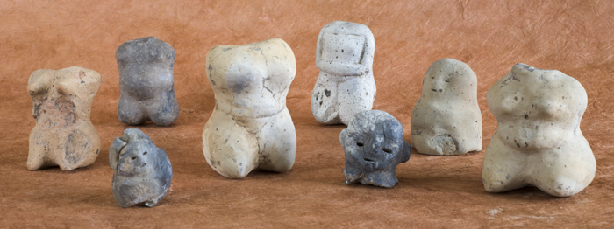
Clay figures
Photograph © Jenny Ellerbe
Notes:
Poverty Point – 1700 B.C. to 1100 B.C.
Poverty Point people also made small figures from fired-earth. Many of the torsos resemble women. The heads are removed or missing from many of these figures. Archaeologists are not sure how the people used these figures, but they might have been for special purposes, like ceremonies.
Image credit: © Jenny Ellerbe

Slide 26
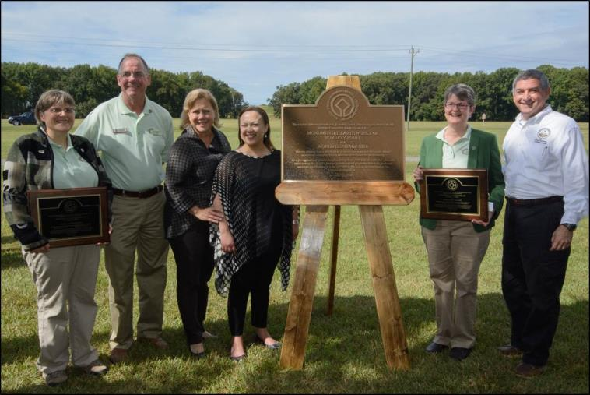
Poverty Point named a World Heritage Site
Poverty Point World Heritage Site Plaque, October 11, 2014
Notes:
Poverty Point – 1700 B.C. to 1100 B.C.
Poverty Point became a World Heritage site on June 22, 2014. This is a photograph of the World Heritage plaque. Only 23 sites in the U.S. are on the World Heritage Site list. Some sites you may recognize on the list are the Grand Canyon in Colorado (a natural site), Monticello in Virginia, (the home of Thomas Jefferson), the Pyramids of Giza (Egypt), and Stonehenge (England). The Poverty Point World Heritage Site is open to the public. Many artifacts discovered at the site are on display at the site’s museum. You can also tour the mounds. There are regular events scheduled at the site, such as flint knapping workshops and volunteer days for archaeology. You can find out more about this World Heritage Site at http://whc.unesco.org/en/list/1435.
If you’d like to know more about this unique site, visit www.povertypoint.us, as well as the interactive website exhibit at http://www.crt.la.gov/DiscoverArchaeology, KnowLA.org at http://www.knowla.org/entry/540, and the Office of State Parks website at http://www.crt.state.la.us/louisiana-state-parks/historic-sites/poverty-point-state-historic-site/index.
Image credit: Louisiana Office of Culture, Recreation and Tourism

